Slide 1
Title I, Part A Annual Overview of the Title I program
Crookshank Elementary School 2021-2022

Slide 2
Purpose of Meeting
Federal guidelines require Title I schools to hold an Annual Meeting to explain and discuss Title I programs and requirements.

Slide 3
What is Title I?
Title I is a federal grant that:
provides supplemental funds to approved schools to meet educational goals
supports the professional development of teachers
supports parent engagement programs

Slide 4
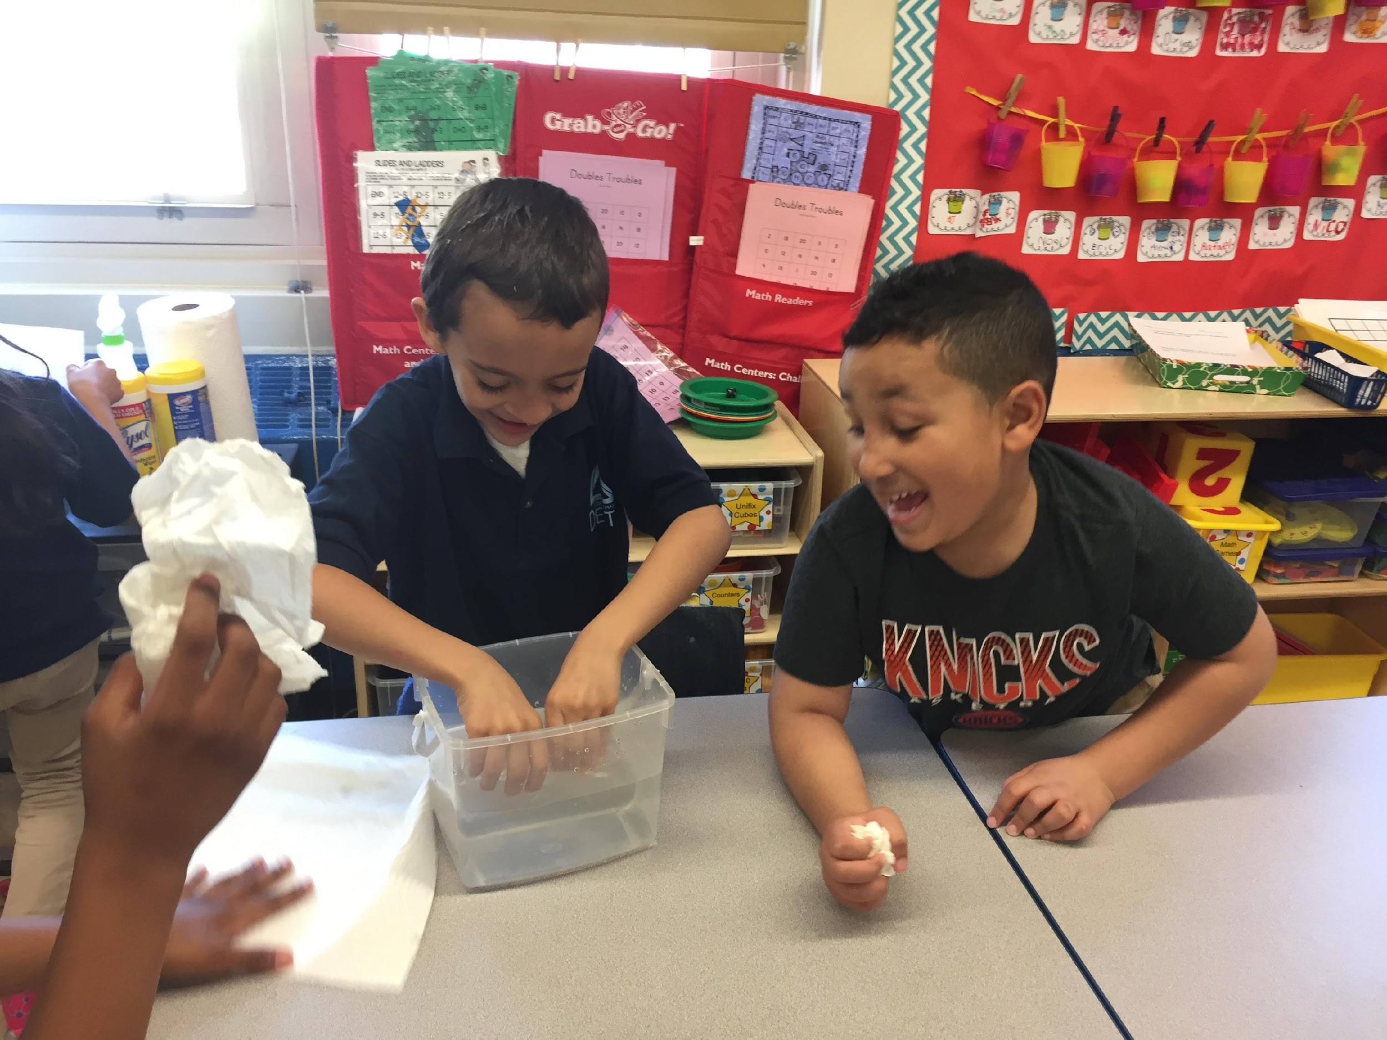
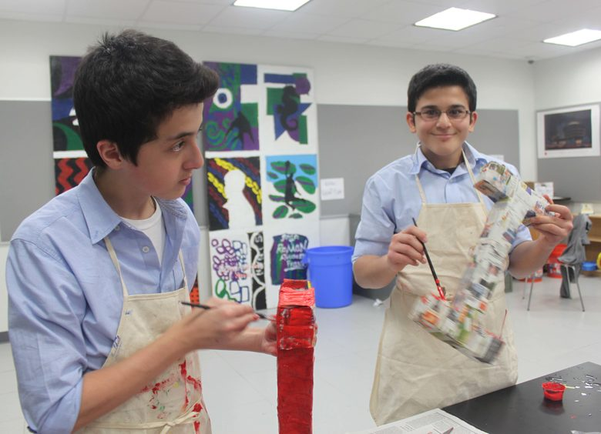
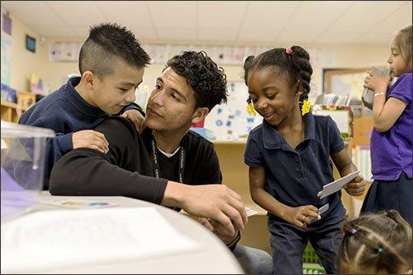
Schoolwide Title I Programs
Equipment,
Materials,
Trainings
Tutoring Opportunities
Parent and Family Engagement Activities
Coaches:
Reading
Math
Science

Slide 5
Parent and Family Engagement Plan
Referred to as the PFEP
Describes how the school will carry out the parental engagement requirements
Developed jointly with parents

Slide 6
Parent and Family Engagement Plan
Title I schools must:
Provide information on how the school works with parents, community, volunteers, and business partnerships to increase student achievement
Provide trainings to staff on effective strategies to engage parents in their children’s education
Provide academic parent trainings designed to increase student achievement
Explain the curriculum, assessments, and the minimum standards that students are required to meet
Notes:
Developmental meeting parent opportunity to provide input, held in spring

Slide 7
School-Parent Compact
Each Title I school must have a School-Parent Compact
The compact sets out the responsibilities of the students, parents, and school staff in striving to raise student achievement
You completed this compact at the beginning of the year.

Slide 8
Your Parent Engagement Matters!
Research by Epstein and Associates in 2009 shows no matter the socio-economic status, when parents are involved, students are more likely to:
Attend school regularly
Earn better grades
Obtain better test scores
Be promoted to the next grade
Adapt to change
Have better social skills
Graduate
Continue their education

Slide 9
School and Parent Partnership
School will work with parents to ensure child’s success
School and parents should jointly make decisions that affect child’s education
Your input is vital to your child’s education
Notes:
You are your child’s advocate

Slide 10
School and Parents
School and parent partnerships are built within Advisory Councils (School and District)
School provides opportunities for parents to volunteer time and talents
School offers parent workshops, trainings, parent/teacher conferences, and Family Resource Centers

Slide 11
Students Experiencing a Time of Transition
The McKinney-Vento Act: Who are eligible for services?
Families who, due to a loss of housing, live:
in a shelter, motel, vehicle, or campground
on the street
in abandoned buildings
or are doubled-up with relatives or friends
Eligible children in transition have rights and privileges under the McKinney-Vento Act.

Slide 12
Students Experiencing a Time of Transition
Every school district has a Transition Education Liaison who helps to:
Decide which school would be best for the child
Communicate with the school
Provide school supplies, uniforms, supplemental services and free school meals
Set up transportation to and from the school of origin
Find community support
Please reach out if you need assistance

Slide 13
Parents are our greatest partners and advocate in their child’s education!
Thank you for supporting our Cougars!
Notes:
Who does this portion?

